Slide 1
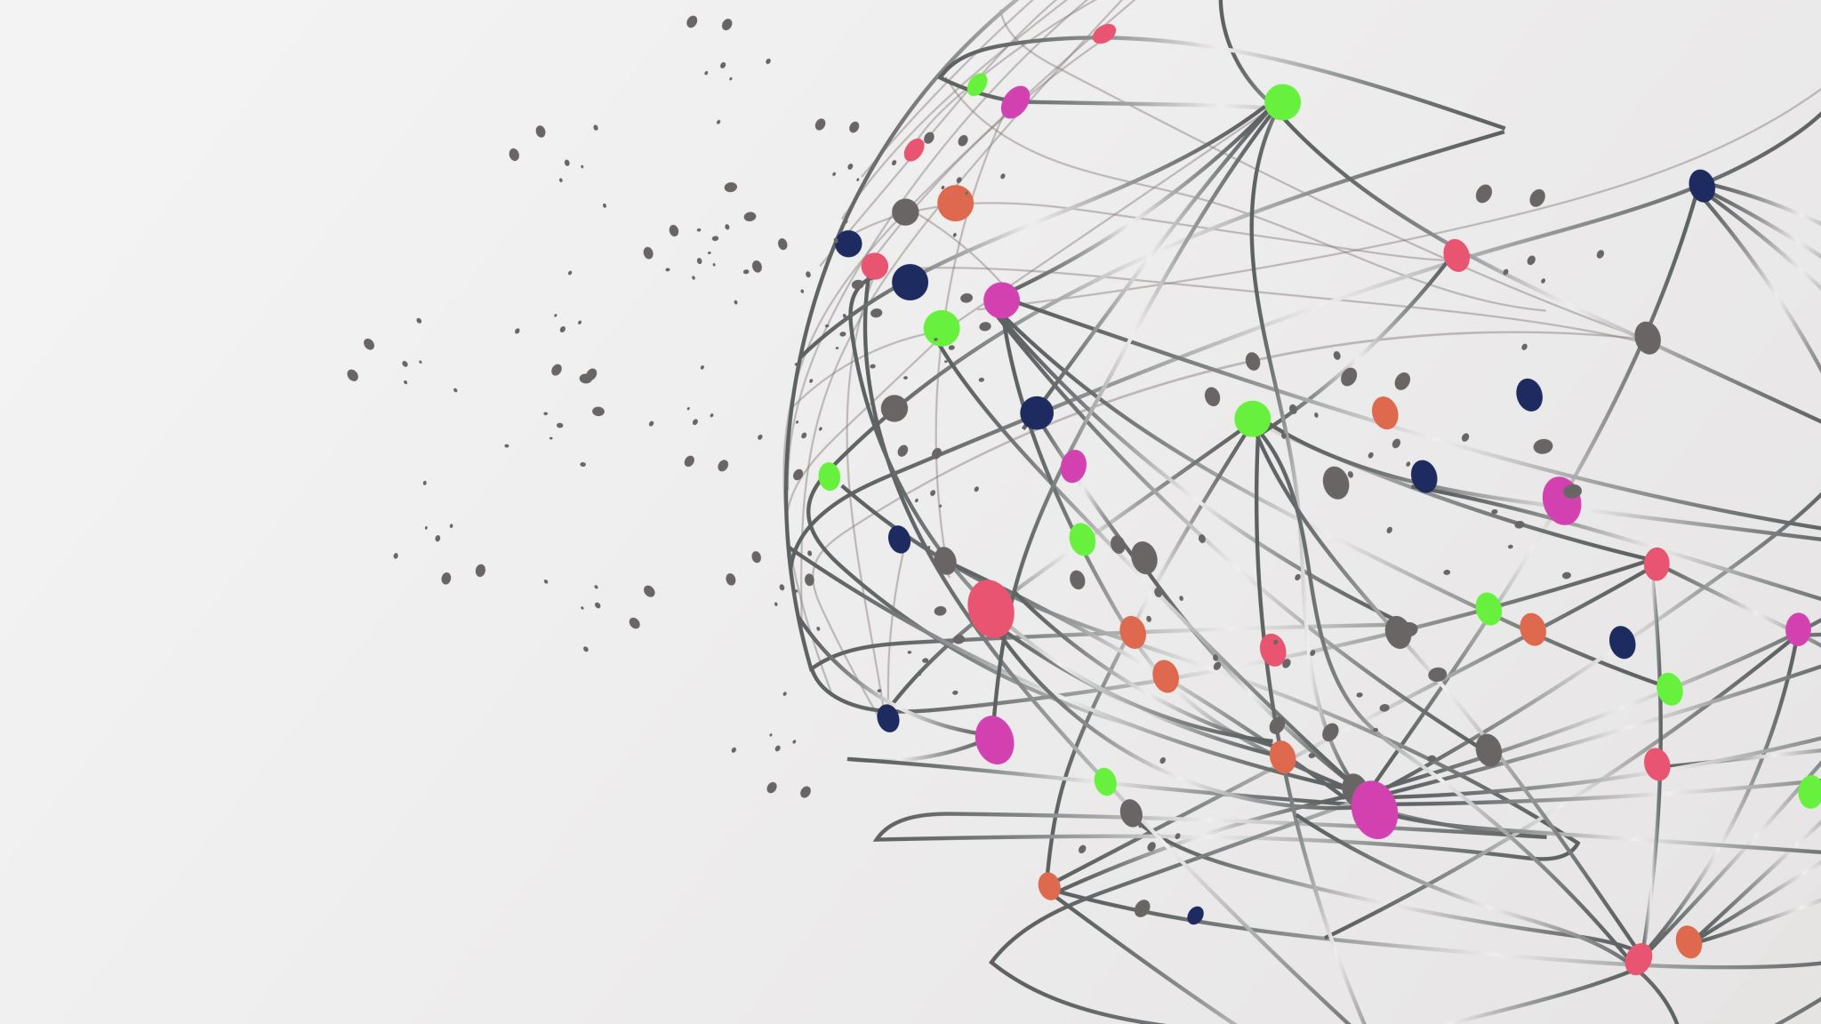
Project C Ethical Hacking
Gustavo Nieves
Cohort 23C

Slide 2

Summary
Install and Configure a new server in their internal network to support production and operations
Determining the vulnerabilities of the new production server as well as webserver and provide useful examples of how any vulnerabilities could be exploited

Slide 3
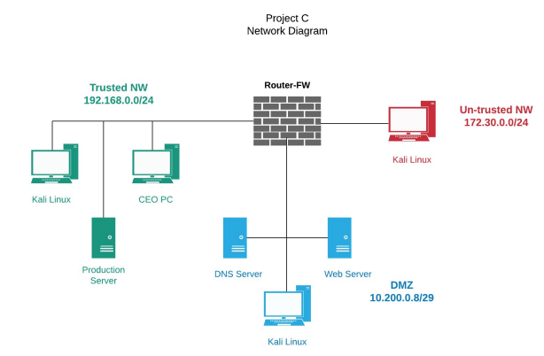
Network Diagram

Slide 4
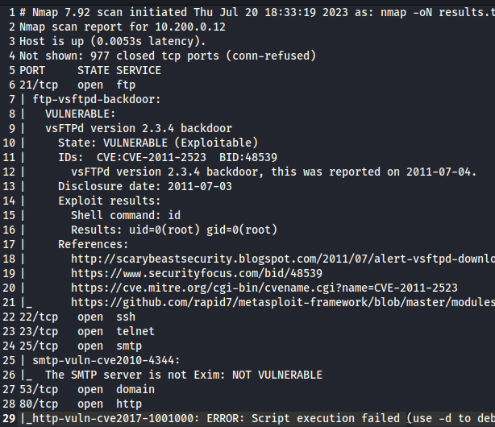
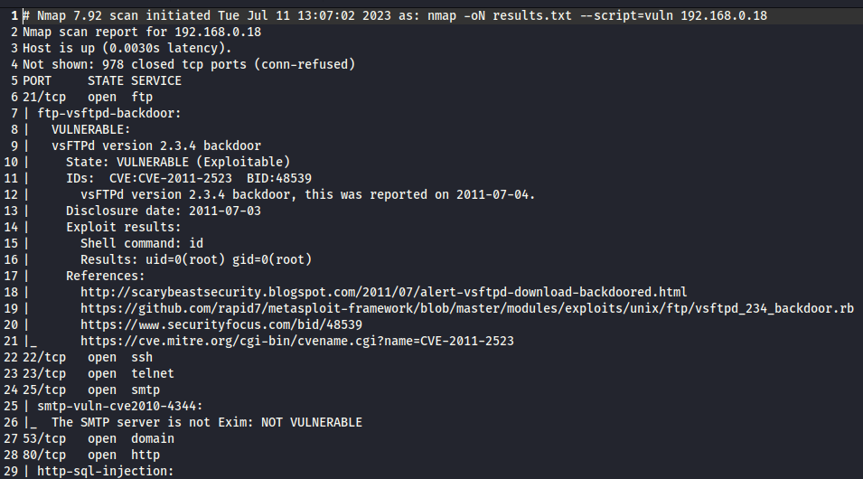
Vulnerabilities
Web Server
Production Server

Slide 5

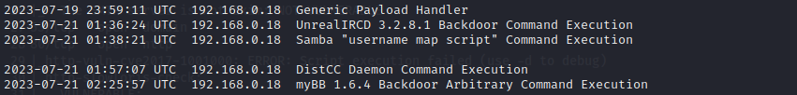
Exploits in Production Server

Slide 6
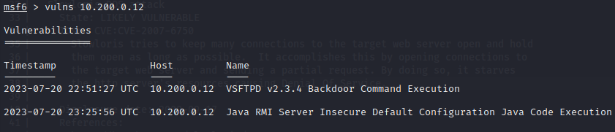
Exploits in Webserver

Slide 7
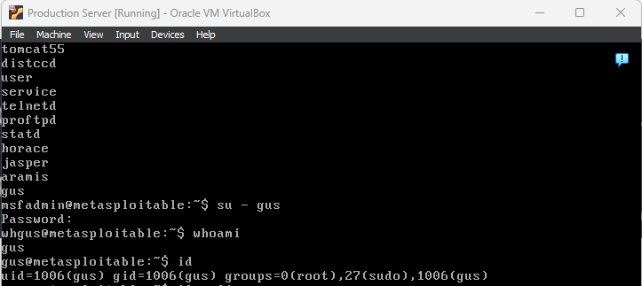

Production Server Account

Slide 8
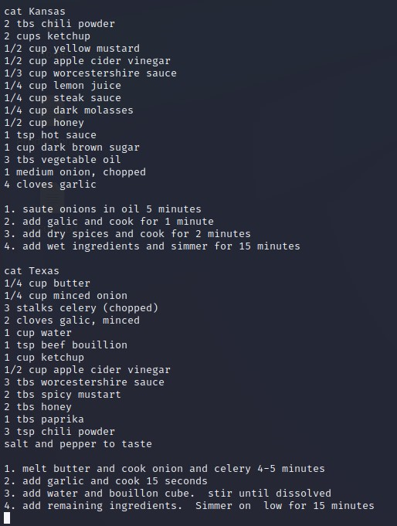
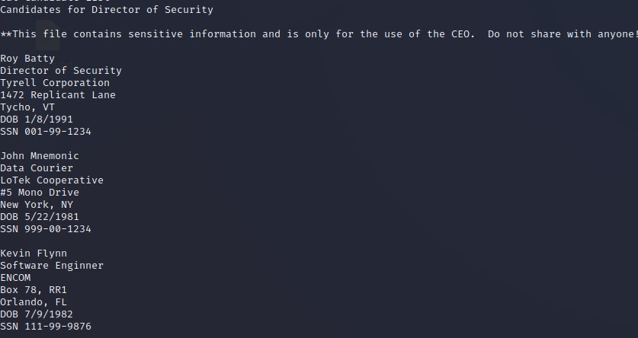
Interesting Files

Slide 9
Recommendation
Change to Secure File Transfer Protocol
Establish password requirements
Use a Secure Connection
Update and Upgrade Software Regularly

